Slide 1
  Learning By Failing

Slide 2
Today,
I’m going to tell you about a time I failed…

Slide 3
…over, and over again…

Slide 4
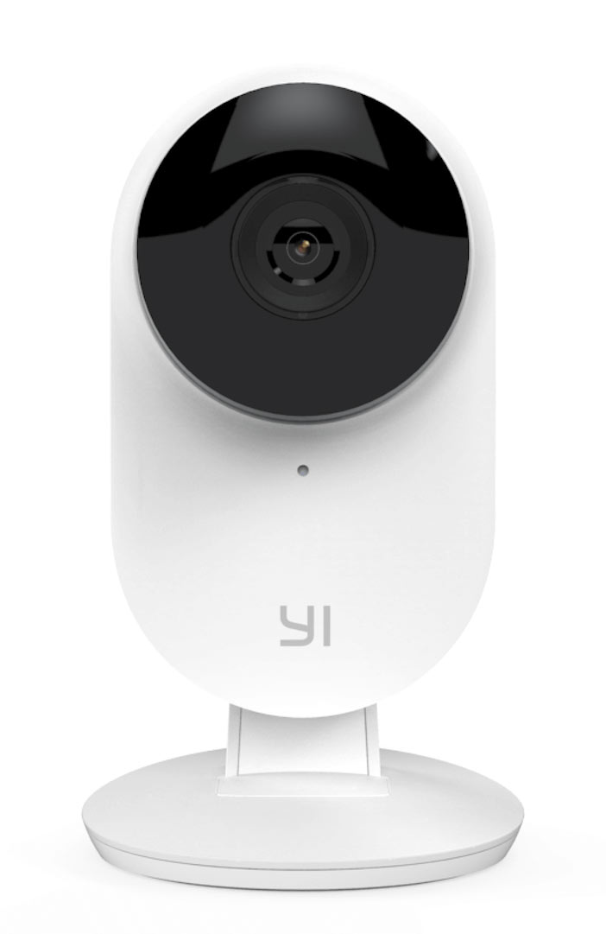
A while a go, I bought a cheap security camera.
Notes:
A while a go, I bought a cheap security camera.
I thought I would make a fun little project out of hacking it and at the same time see how secure it really was.
Plus, I got had just been broken into and was feeling extra paranoid…

Slide 5
My ideal IoT Camera
Does not spy on me.
Convenient to use.
Does not spy on me.

Slide 6
How secure is this thing really?
Can I SSH into it? Nope.
How about telnet? Nope.
Are there any open ports? Nope.
Notes:
Thankfully, I wasn’t the first person to want to dig a little deeper.

Slide 7
GitHub to the rescue!
Notes:
I came across a project on GitHub that produced a repackaged versions of the firmware with SSH added.

Slide 8
nadav@mini:~/Projects$ ssh root@c1.local
root@c1.local's password:
Welcome to HiLinux.
~ #
Notes:
All I had to do is put the modified firmware images on the camera’s MicroSD card.
On boot, this flashes the internal camera’s memory giving us a root shell over ssh (and the glorious screen you see before you).

Slide 9

Show me your dirty secrets.
/home/app # cat cloudAPI | grep htt
http://openapi.kuaipan.cn/open/verificationURL
http://openapi.kuaipan.cn/1/account_info
http://openapi.kuaipan.cn/1/fileops/create_folder
http://openapi.kuaipan.cn/1/fileops/delete
http://openapi.kuaipan.cn/1/metadata/app_folder
http://api-content.dfs.kuaipan.cn/1/fileops/upload_locate
Notes:
After a bit of digging, I found some interesting strings in some of the camera’s binaries. I’ve highlighted them on the screen. It looks like the video files are uploaded using HTTP to a shutdown file sharing site… Not my definition of secure.

Slide 10
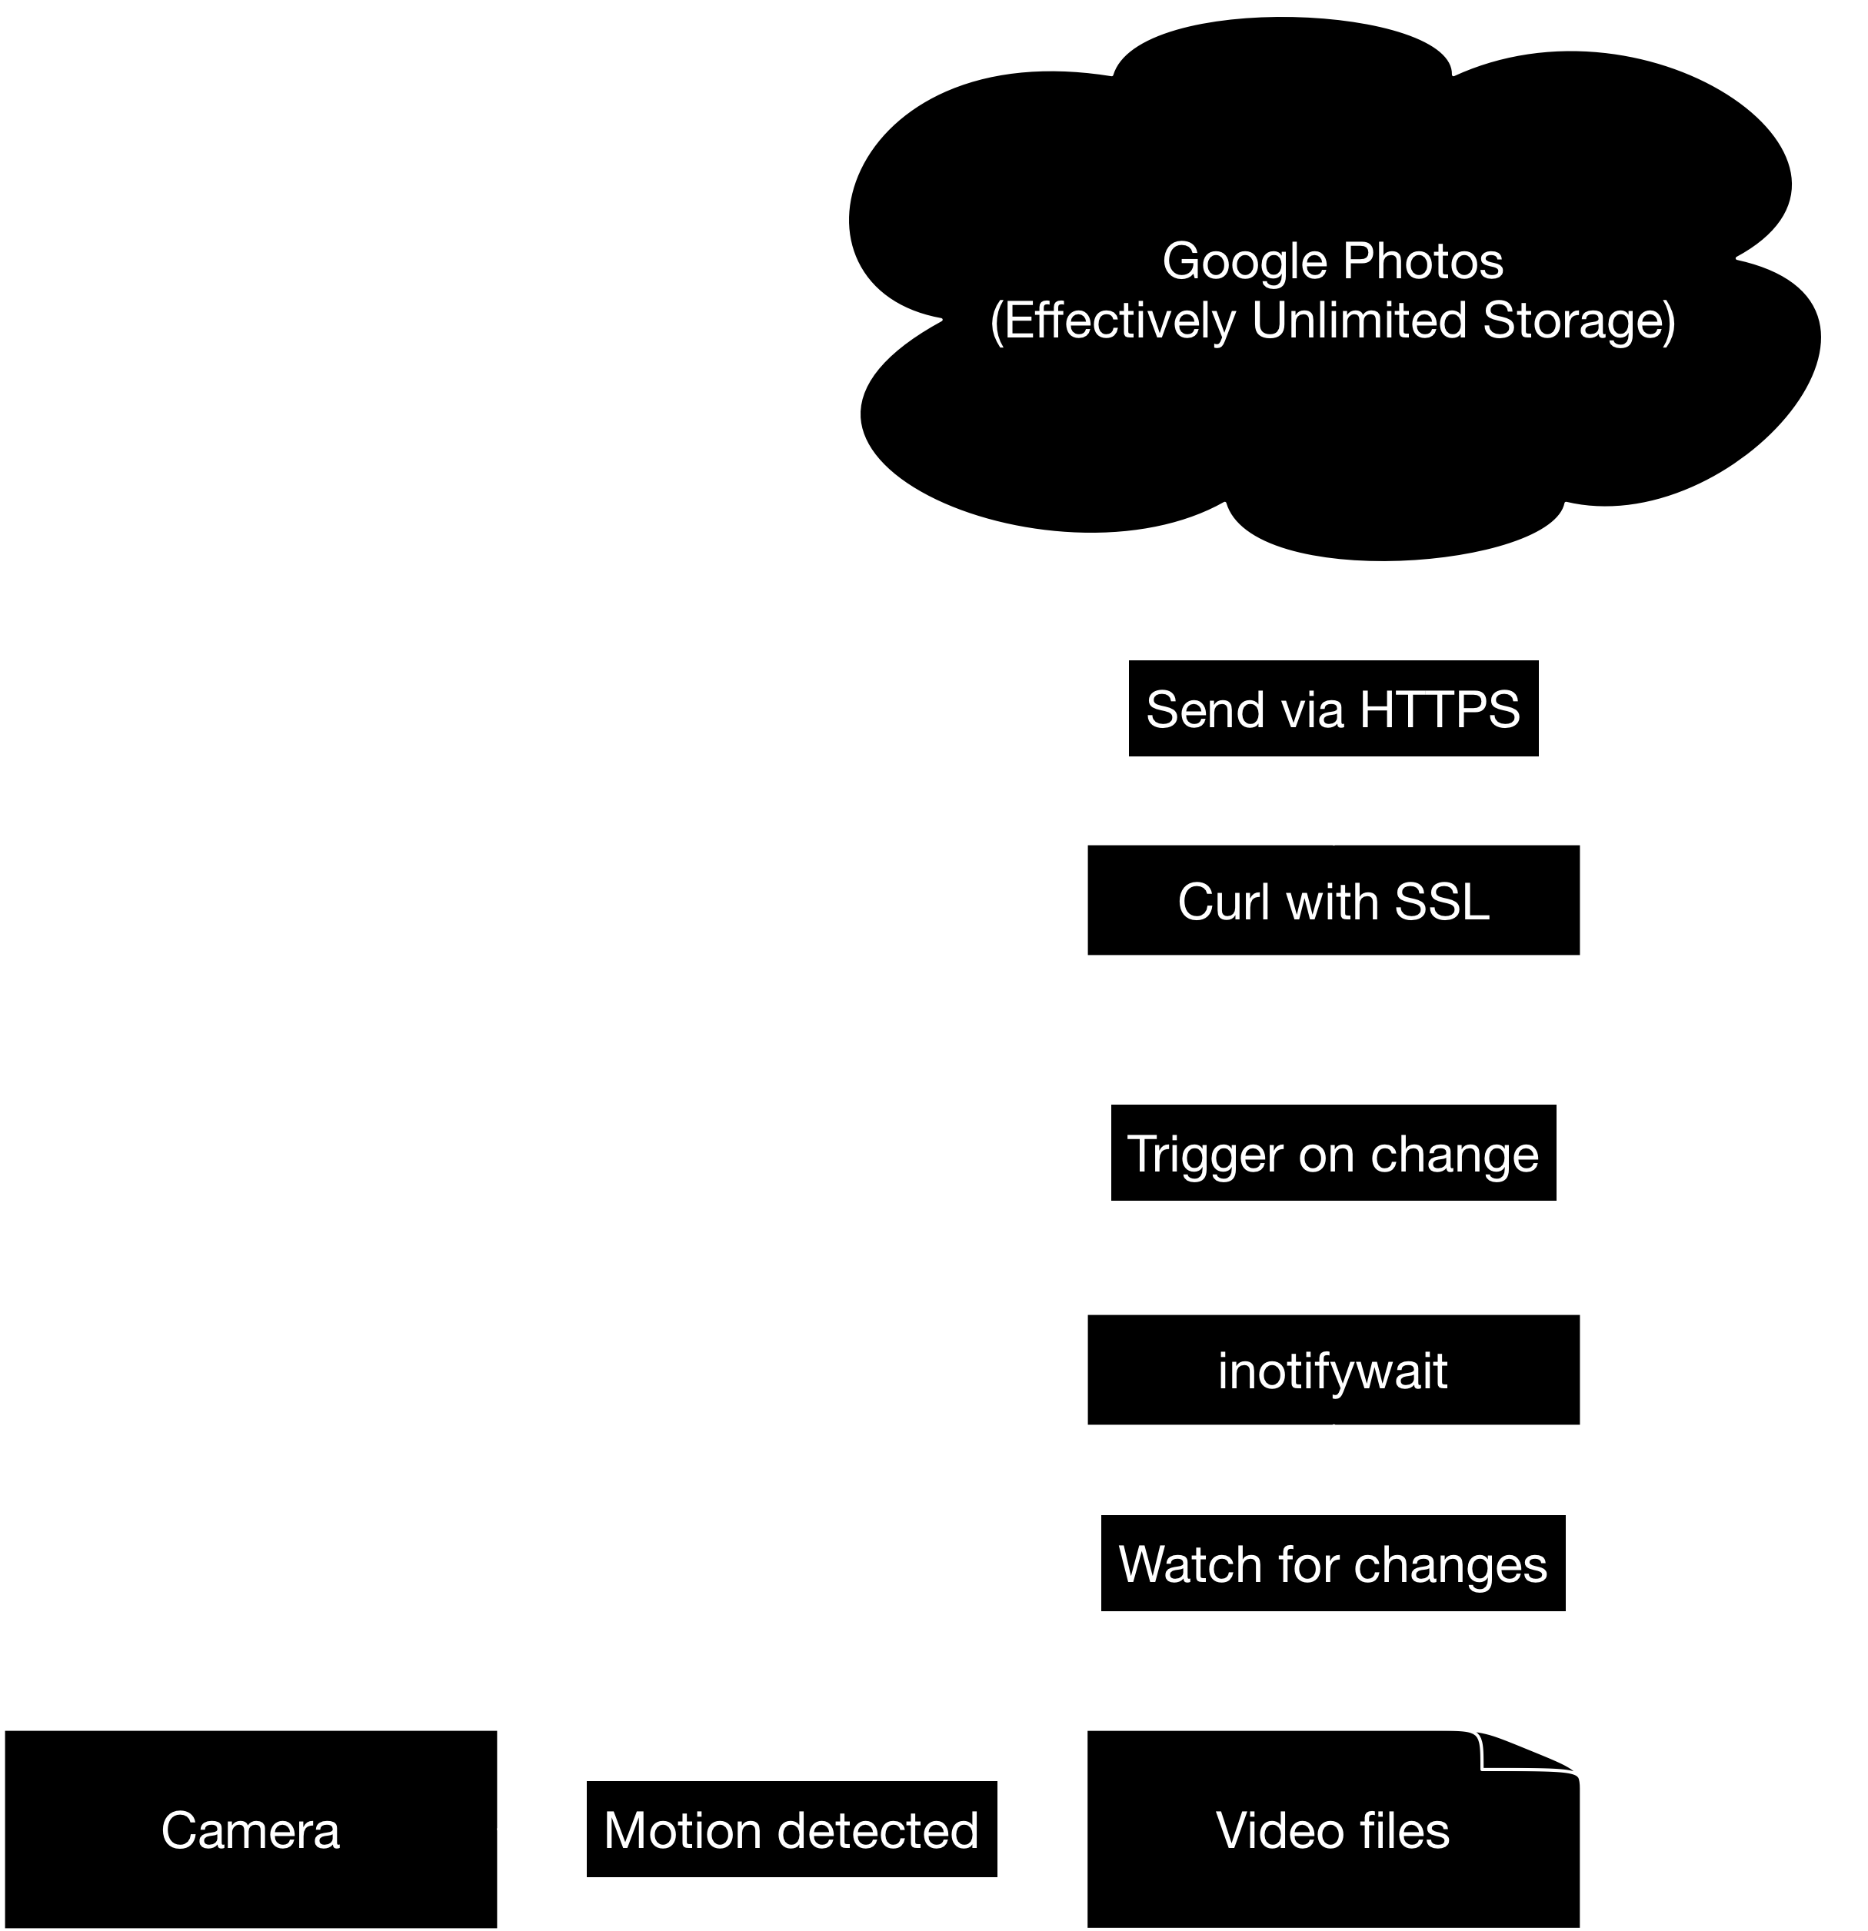
Notes:
So, I set off to make it better.
First, needed a way to watch for changes to the filesystem because a new file is written when motion is detected. Then, on change, I can trigger an HTTPS request to the server of my choosing with the contents of the file. My design looked a little like this.

Slide 11
Compile all the things.
Notes:
Unfortunately, the camera only had a limited number of utilities installed. So, I needed to compile inotifywait as well as Curl with SSL support. My one stroke of luck came in the form of an SDK.

Slide 12

^ how using the SDK feels ^
Notes:
After about a day of struggling and failing to compile anything, I managed to install the SDK and compile the needed binaries.

Slide 13
Getting the binaries on the camera.
(cue ominous music)
Notes:
Here’s where things really started to spiral out of control…

Slide 14
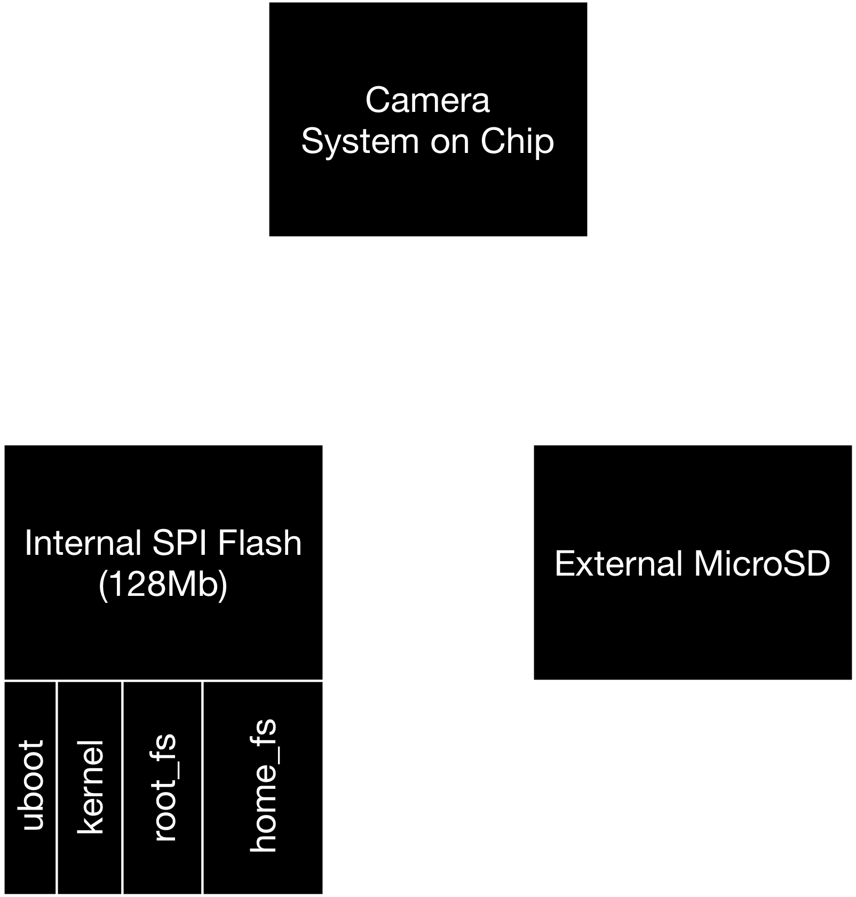
A rough view of the camera storage.
Notes:
The camera’s storage is separated into two parts:
An onboard SPI flash chip similar to the type you mind find in a PC storing the BIOS. On the camera, it stores the boot loader, kernel, root filesystem, and home file system.
An external MicroSD card to store the full length recordings.

Slide 15
128 Mb != 128 MB
Notes:
In order to keep costs down, the flash chip has was sized to just fit it’s contents and is almost entirely utilized. 128 Megabits is only 16 Megabytes. This didn’t leave much room for curl and my other utilities.

Slide 16

Notes:
I needed to free up some space for my new binaries, so I deleted files I thought the camera might be able to live without…

Slide 17

I bricked it.
Notes:
I bricked the camera, and it would no longer boot.

Slide 18
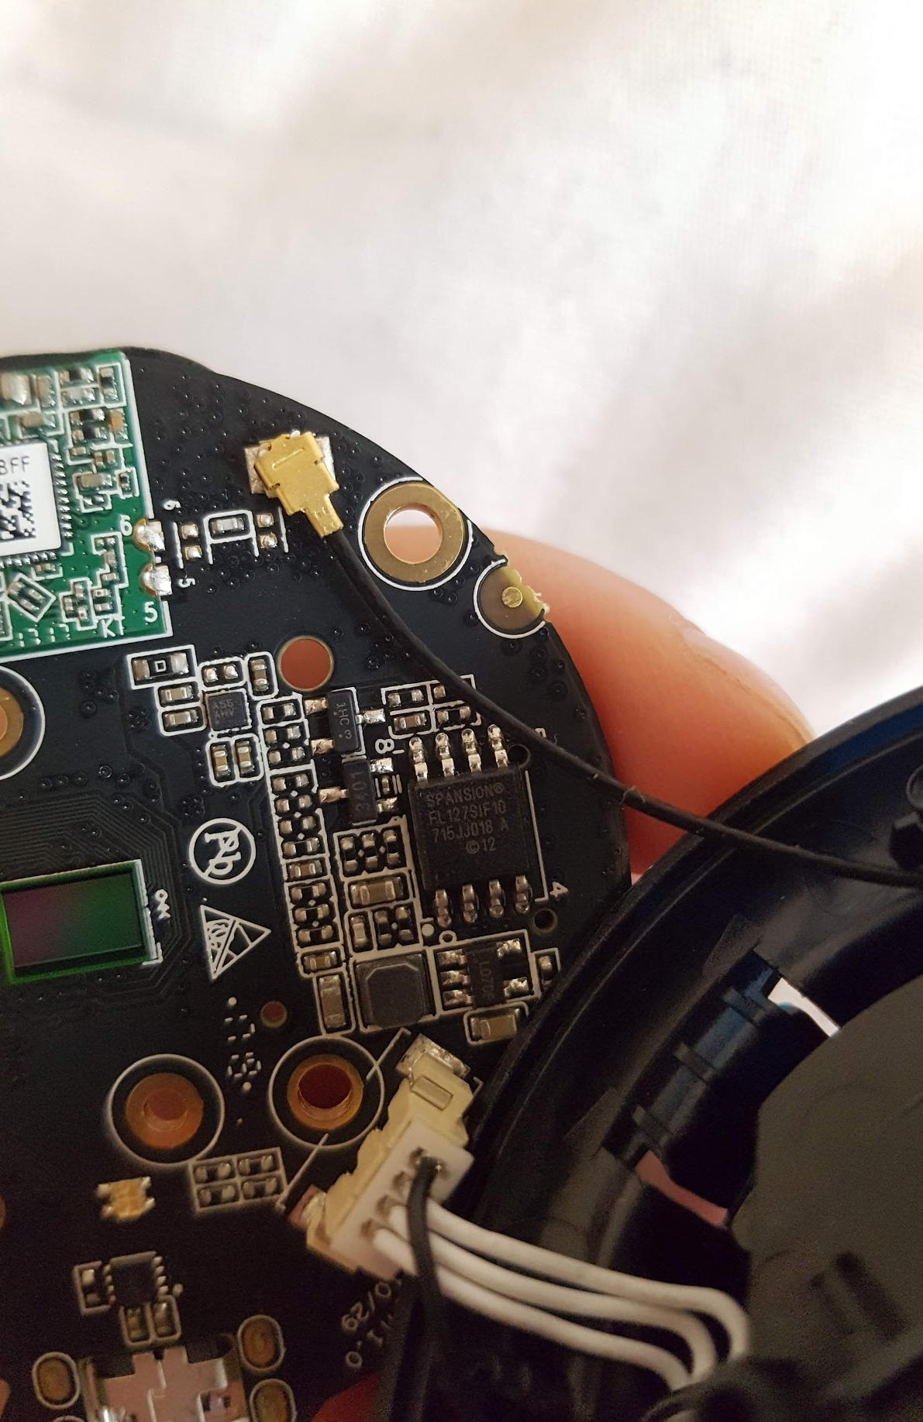
Tear it to bits.
1.27mm
SPI Flash
Notes:
So I took the “obvious” next logical step. I would take the camera apart and manually reprogram the onboard storage so I could then fit my binaries and make the camera secure.
I tried connecting tiny test clips to it, but no luck, I couldn’t make a reliable connection and I couldn’t be sure that other elements of the camera we’re affecting the flash chip.

Slide 19
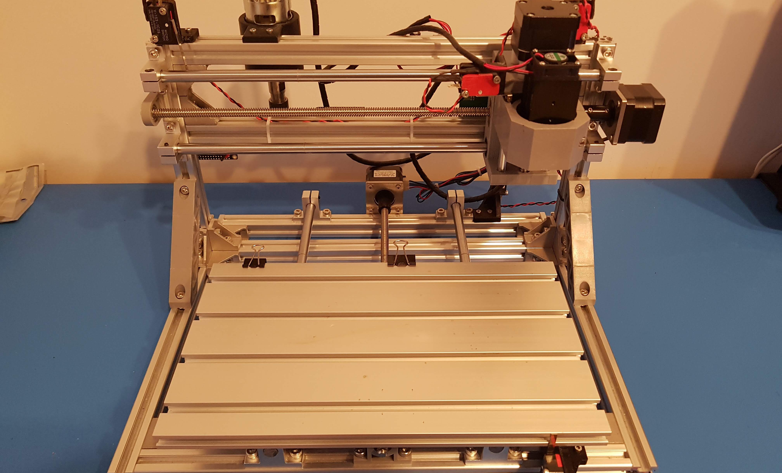
Custom adapter?
Notes:
A few weeks before this all started, I got myself a small CNC Mill / Laser Engraver. The idea being that I could eventually make my own prototype printed circuit boards from my apartment. What better time to start when you’re neck deep in another project…
Down the rabbit hole I went.

Slide 20

Notes:
With my new mill smiling from across the room, I decided the next thing to do was desolder the chip to take it out of circuit and make myself an adapter so I manually reprogram the onboard storage so I could then fit my binaries and make the camera secure.

Slide 21
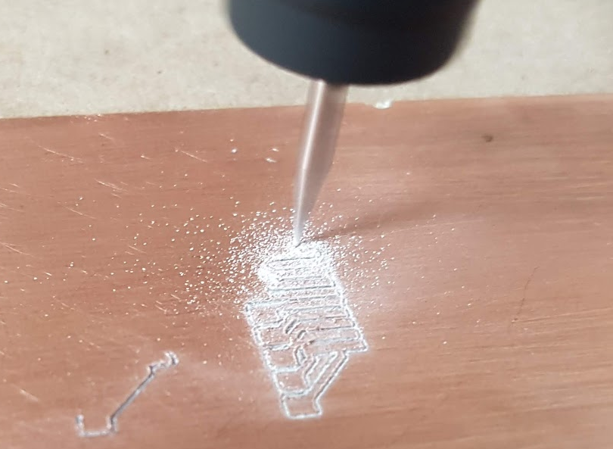
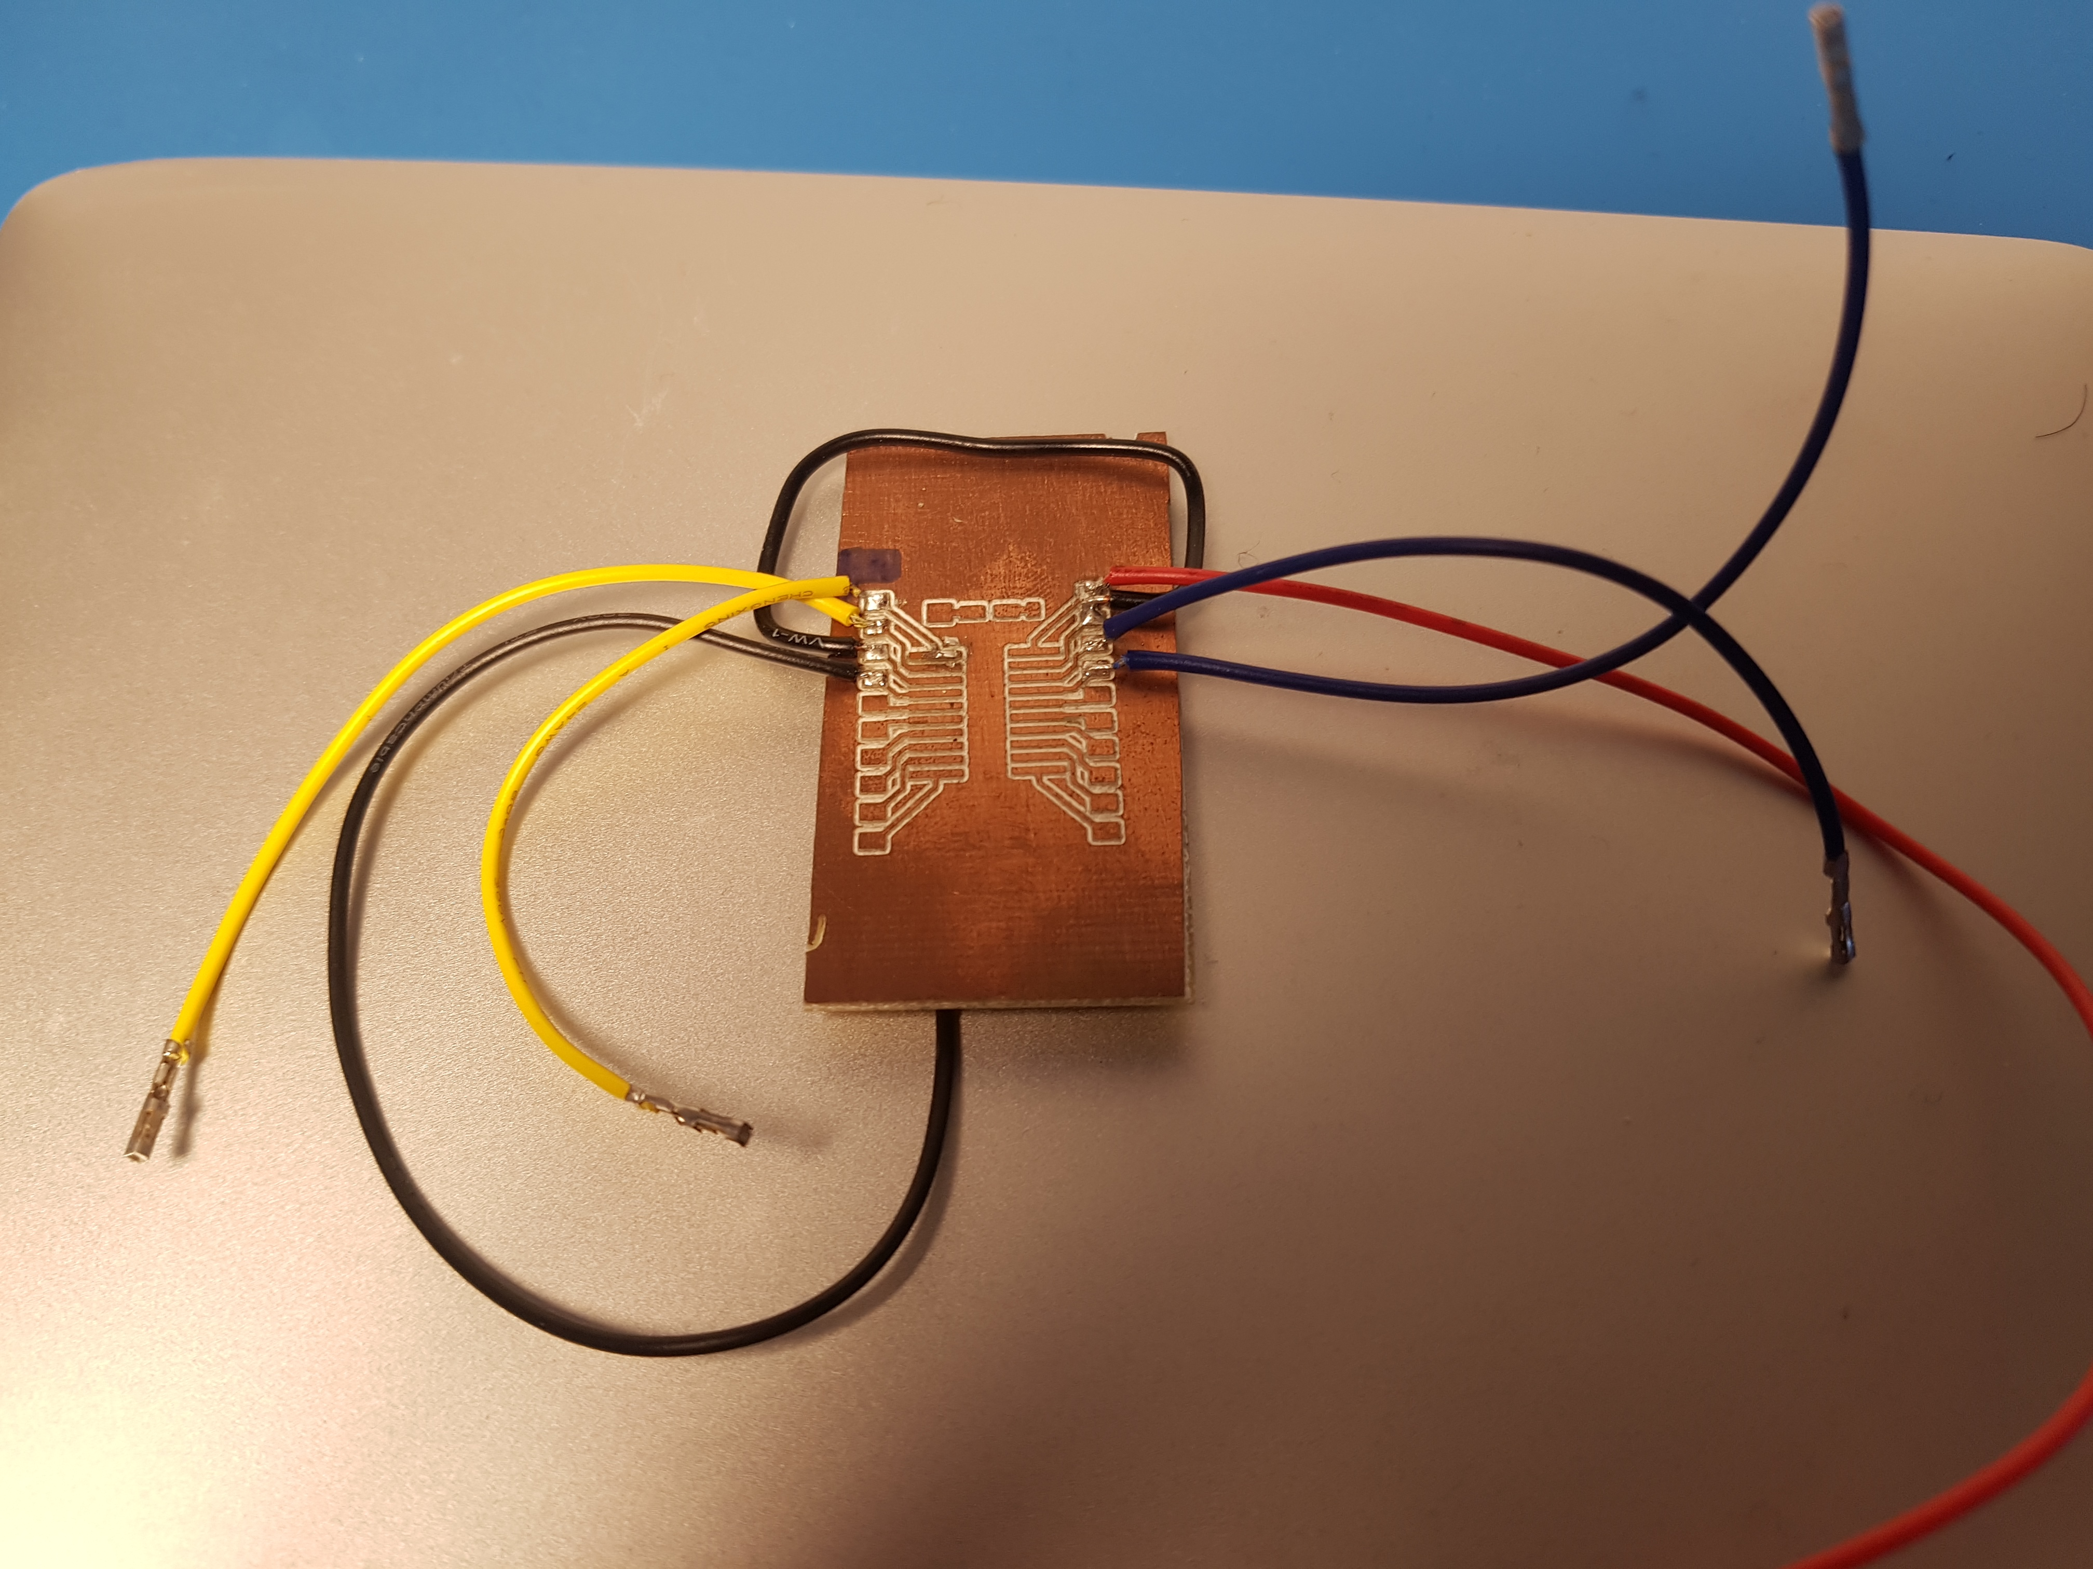
Notes:
Here’s what that adapter looked like. A little rough, but a good first attempt.

Slide 22
nadav@mini:~/Projects$ flashrom -p buspirate_spi:dev=/dev/tty.usbserial-A100RUBF,spispeed=1M -c S25FL127S-256kB
flashrom v1.0 on Darwin 17.7.0 (x86_64)
flashrom is free software, get the source code at https://flashrom.org
Calibrating delay loop... OK.
No EEPROM/flash device found.
Note: flashrom can never write if the flash chip isn't found automatically.
Notes:
I started up a tool called flashrom which interfaces with my SPI reader/writer to see if it could read the contents of the chip. No luck. Desoldering the flash chip off the camera and onto the new adapter didn’t work.

Slide 23

Notes:
Defeated, I put the camera back together.

Slide 24
But wait, theres more!
Notes:
As I put the final screw back in the camera, an incredible feeling of stupidity swept over me. I had never actually tried using the MicroSD as I had in the past to restore the camera’s firmware that way.

Slide 25

Success! Sort of…
Notes:
When the camera turned back on, it booted fully! The camera’s security is still terrible but at least it turns on!

Slide 26
Things I learned failing:

Slide 27
Cross-compile
Notes:
I’ll be ready next time I try an compile something for a constrained device, in a future where IoT devices rule this will surely be handy. Who knows what kind of trouble I’ll get myself into then…

Slide 28
Mill PCBs at home
Notes:
This opens so many doors for future projects. Using what I learned in this project I was able to laser engrave my toothbrush.

Slide 29
  Google all the things
Notes:
There’s a good chance someone has tried the same thing you’re attempting. Learn from them.

Slide 30
  Chase rabbit holes
Notes:
Let projects explode into huge sagas, it’ll hurt a bit while you’re doing it but you’ll learn an incredible amount.

Slide 31
RTFM
Read the docs and understand them.
Notes:
If I had spent a bit more time reading the SDK documentation, I would have quickly learned that the boot loader checks the MicroSD card for firmware files. Reading the documentation saves time and effort, it’s a skill we can all be better at.

Slide 32
RFTM
(Re-flash the MicroSD)

Slide 33

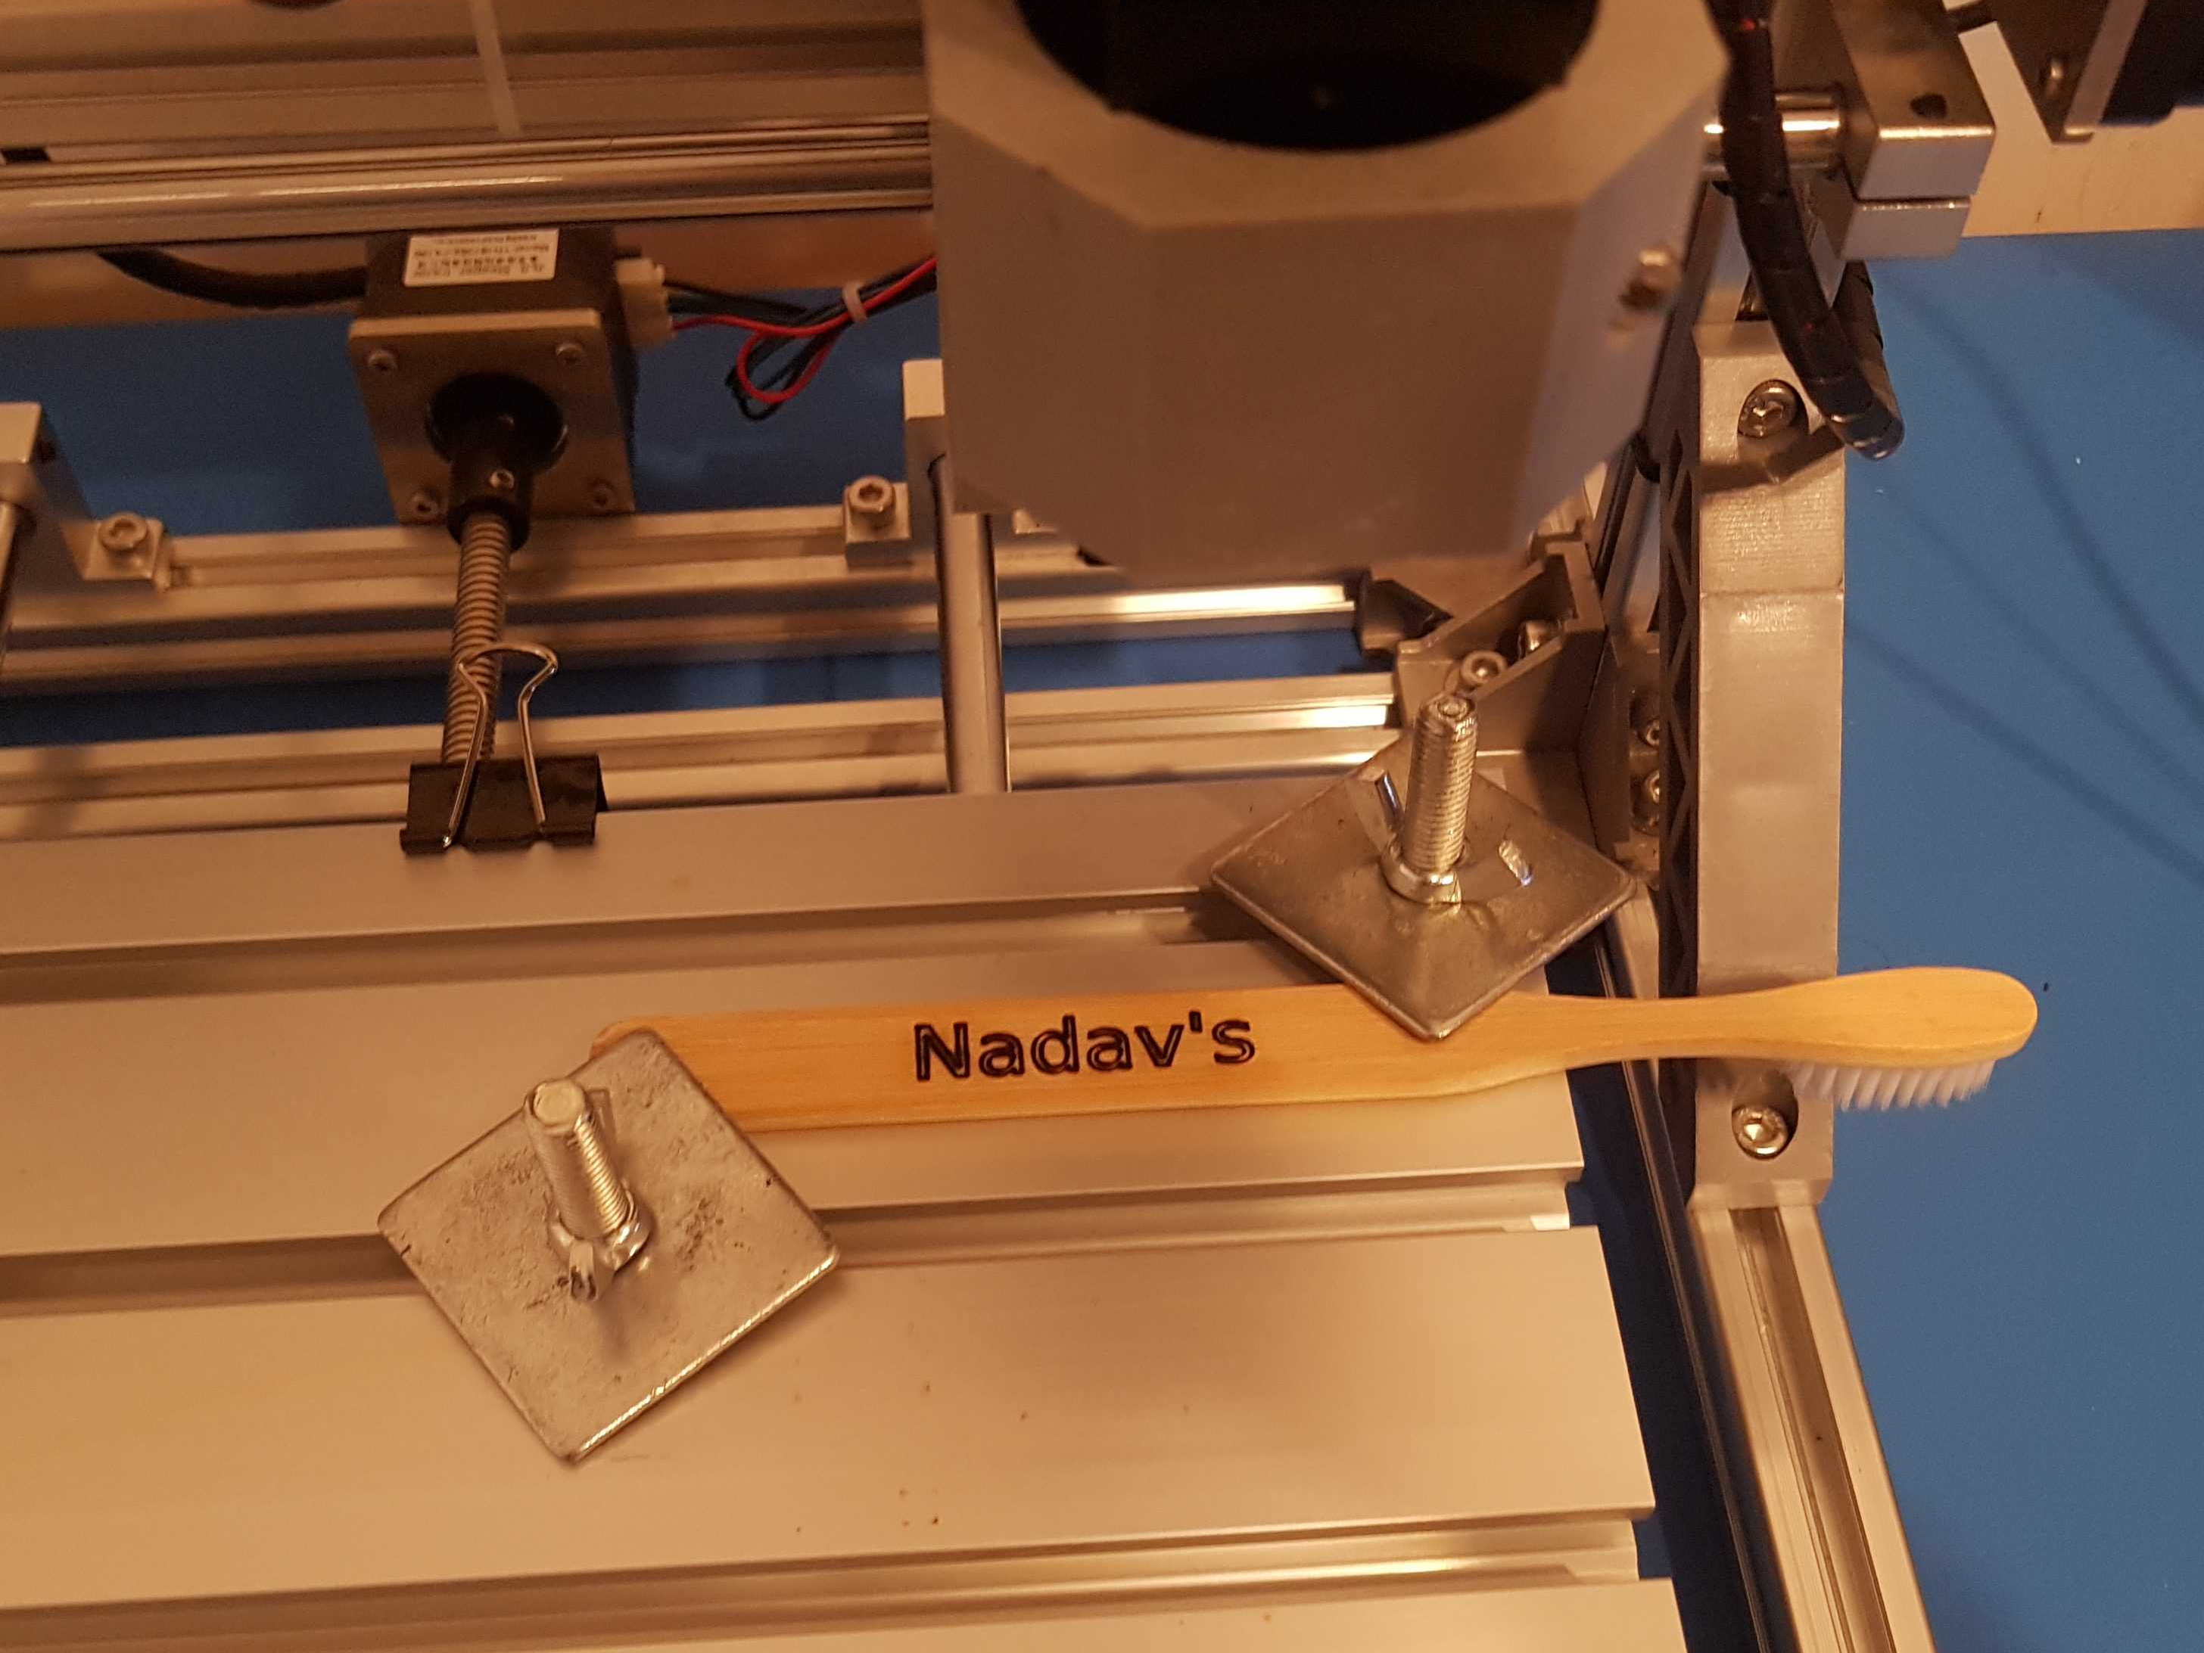
Thank You!
nadavami
My laser engraved toothbrush.
Notes:
Thank you for listening! I’m more than happy to take any questions, comments, insults.

